Slide 1
Local Development Plan
Evidence Gathering
Consultations
Housing Providers Forum
August 2024

Slide 2
Covering
Local Development Planning
Evidence Gathering
  Call for Evidence
  Tell us about your place
Quick Updates
  Local Place Plans
  Self-Build Register
Next Steps

Slide 3
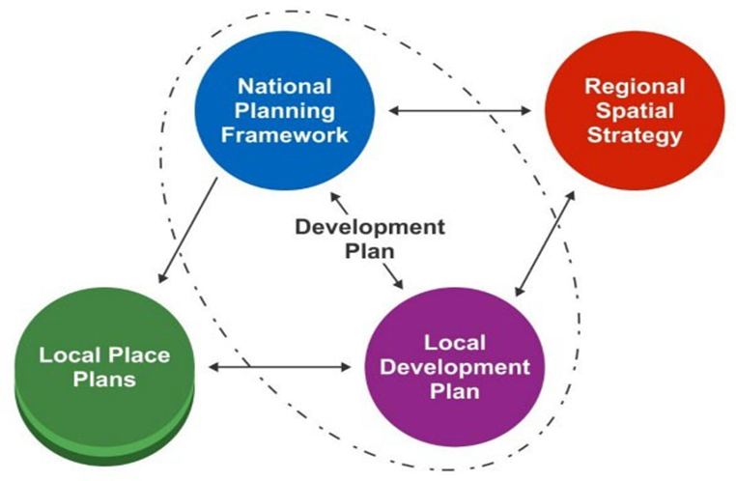
What is the Development Plan?

Slide 4

National Planning Framework (NPF4)
National Spatial Strategy for Scotland to 2045
18 National Developments
33 National Planning Policies
Informs decision making in WDC
National Planning Framework 4 - gov.scot (www.gov.scot)

Slide 5

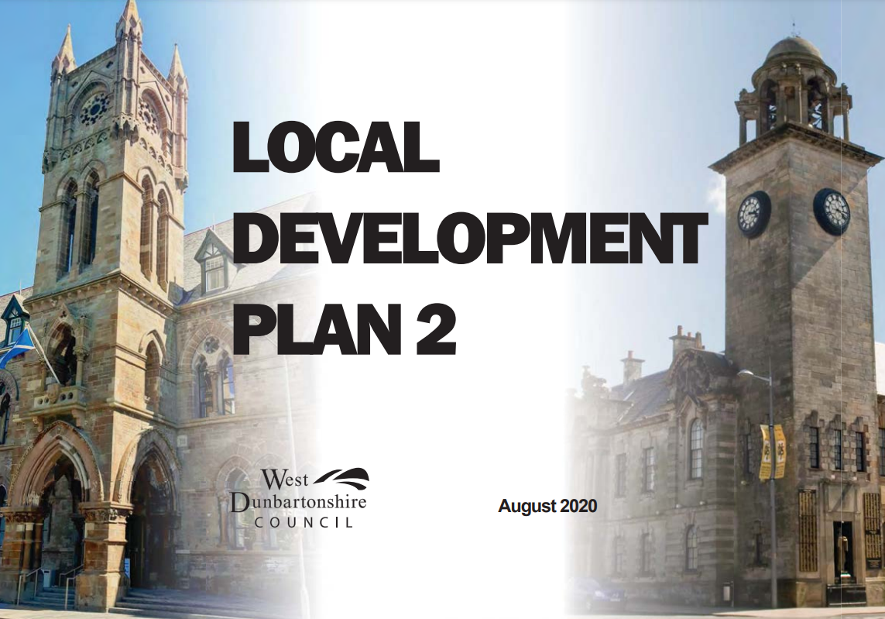
What is a Local Development Plan?
Part of the development plan and the statutory local planning document
Allocates land for development, and protects other areas from development
Prepared every 10 years
Development Plan | West Dunbartonshire Council (west-dunbarton.gov.uk)

Slide 6
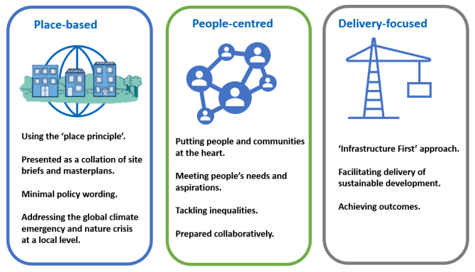
Plans for the Future

Slide 7
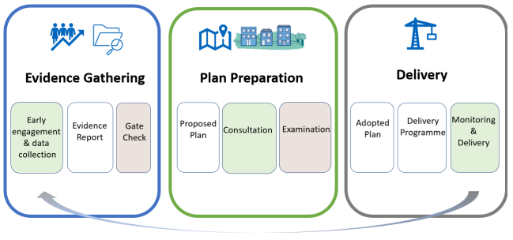
Process Overview

Slide 8
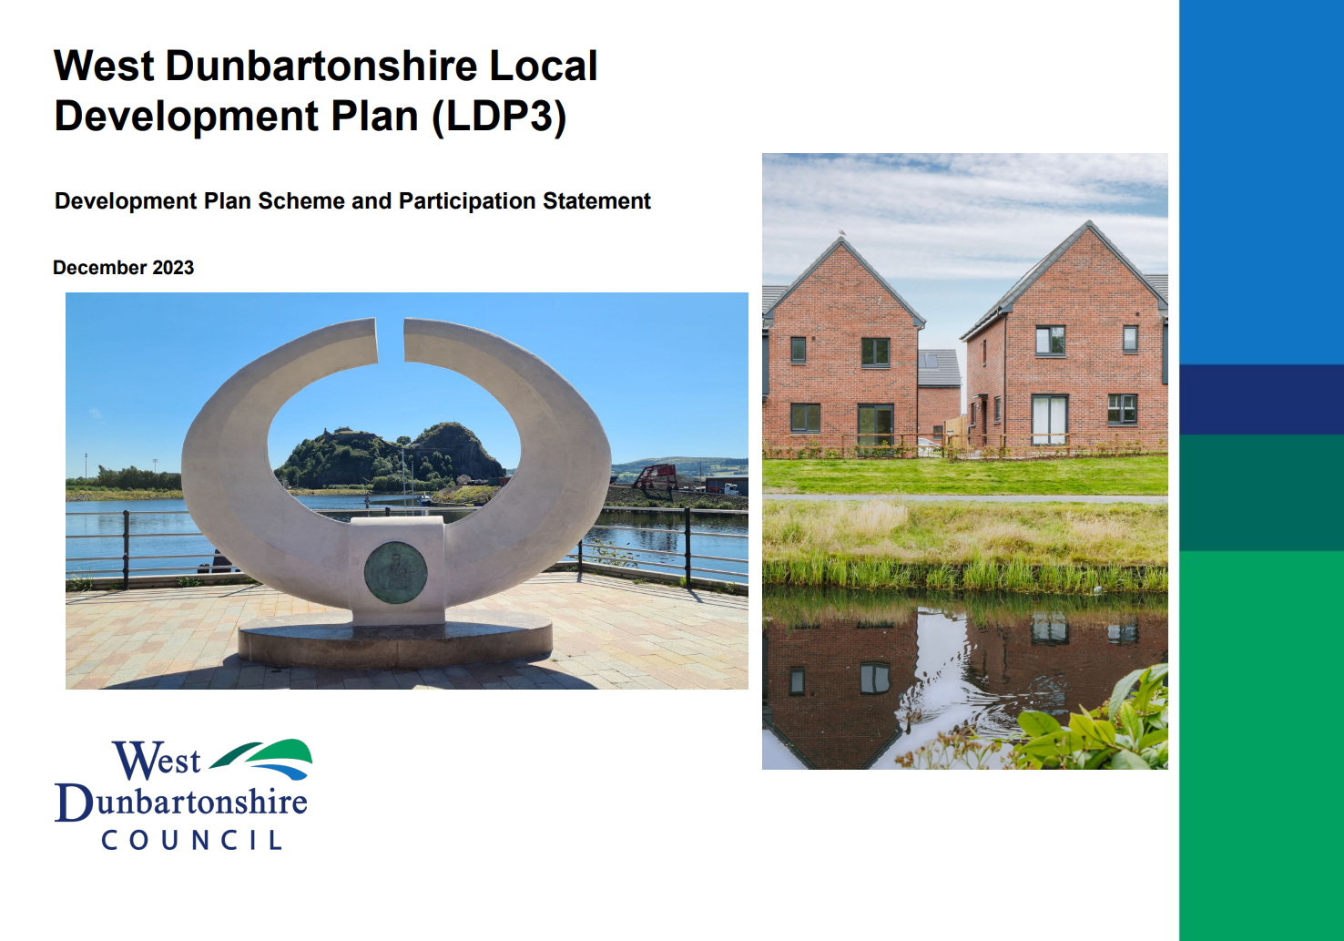
Development Plan Scheme
Adopted in December 2023
Updated Annually
https://www.west-dunbarton.gov.uk/media/h0md3ry3/development-plan-scheme-and-particpation-statement-december-2023-published-version.pdf

Slide 9
Preparation Timeline
Action | Proposed timeline
Publication of draft Development Plan Scheme/Participation Statement | September 2023
Publication of finalised Development Plan Scheme and Participation Statement | December 2023
Publication of Evidence Report and submission for Gate Check | March 2025
Publication of Proposed Plan and draft Delivery Programme | January 2026
Submission of Proposed Plan to the Scottish Ministers for Examination | October 2026
Expected adoption of Local Development Plan | September 2027

Slide 10
Evidence Gathering
Early engagement & data gathering
Supports preparation of the Evidence Report
Evidence Report goes to the Scottish Government’s Department for Planning and Environmental Appeals (DPEA) for a Gatecheck

Slide 11
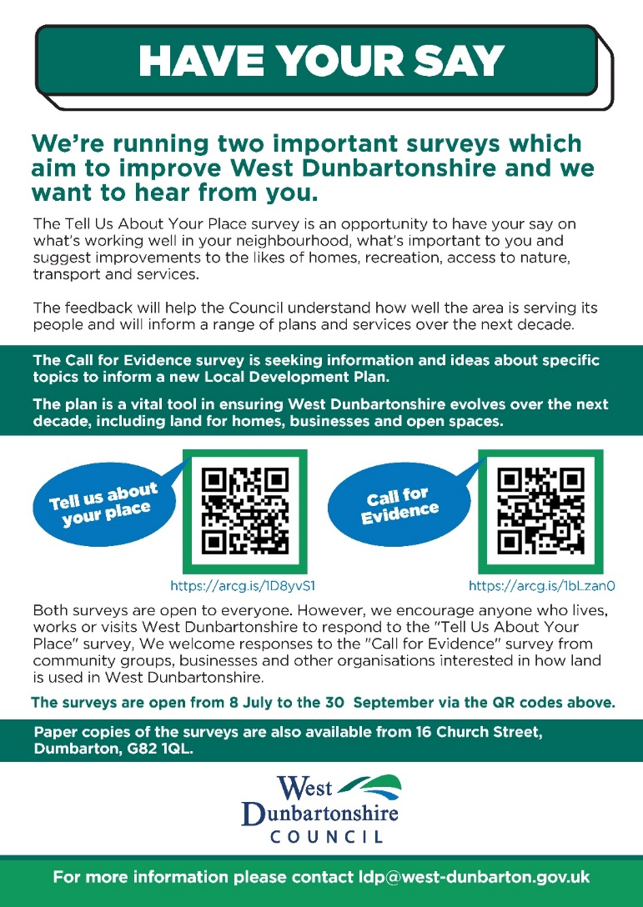
Evidence Gathering: Consultations
“Call for Evidence”
“Tell us about your place”

Slide 12

Call for Evidence
This survey allows you to provide information and ideas about specific places and topics.
The survey is open to anyone, however is likely of most interest to groups with specific interests in how land is used in West Dunbartonshire.
There is a section for information on specific places.
Sections for the 33 policy areas from NPF4.

Slide 13
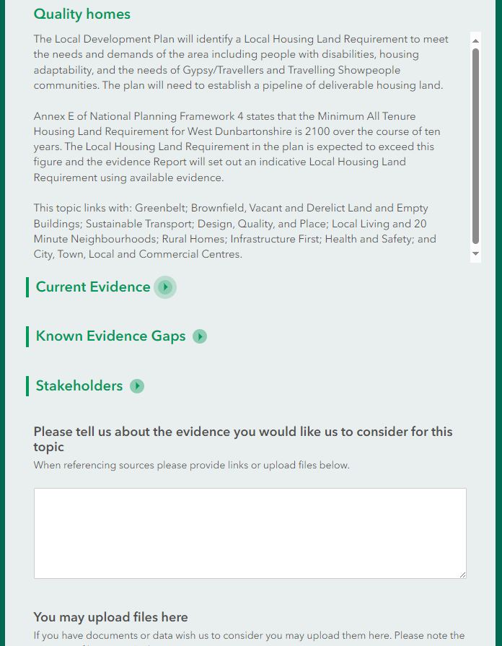
Call for Evidence
Each Topic contains:
  A Summary of the topic
  Connections with other topics
  Current evidence
  Known evidence gaps
  List of relevant stakeholders

Slide 14
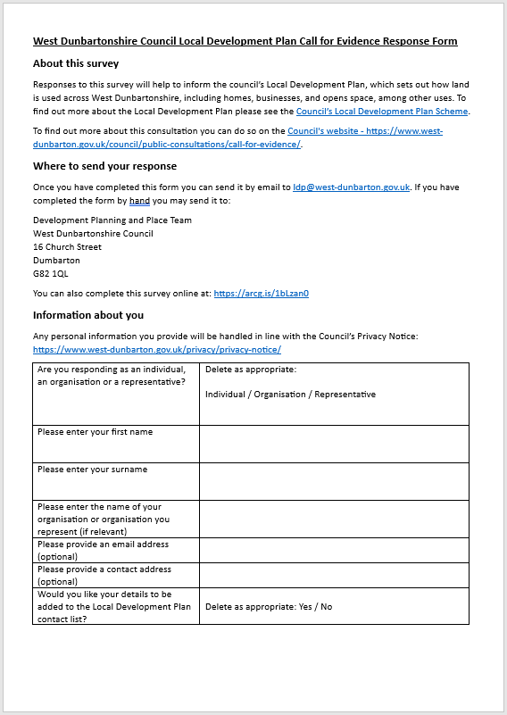
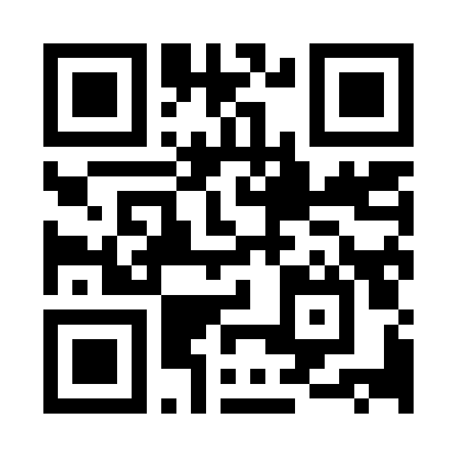
Completing the Survey
Call for Evidence
https://arcg.is/1bLzan0
Paper copies of the surveys are also available at
16 Church Street, Dumbarton, G82 1QL.

Slide 15

Tell us about your place
Place Standard Questions
Linked to the Call for Evidence
Will inform:
  Local Development Plan
  Locality Plans
  Local Place Plans
  Open Space Strategy

Slide 16
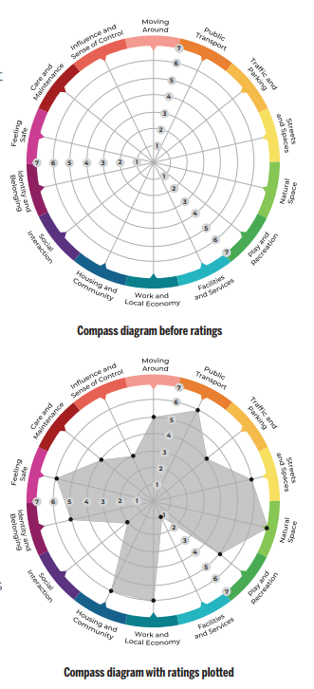
Place Standard Tool
14 Themes
  Main Question
  Additional Prompts
What is good now?
How could it be better?
Score 1-7
  1 = a lot of room for improvement
  7 = very little improvement needed

Slide 17
Themes
Movement
  Moving Around
  Public Transport
  Traffic and Parking
Spaces
  Streets and Spaces
  Natural Spaces
  Play and Recreation
Resources
  Facilities and Services
  Work and Local Economy
  Housing and Community
Civic
  Social Interaction
  Identity and Belonging
  Feeling Safe
Stewardship
  Care and Maintenance
  Influence and Sense of Control

Slide 18
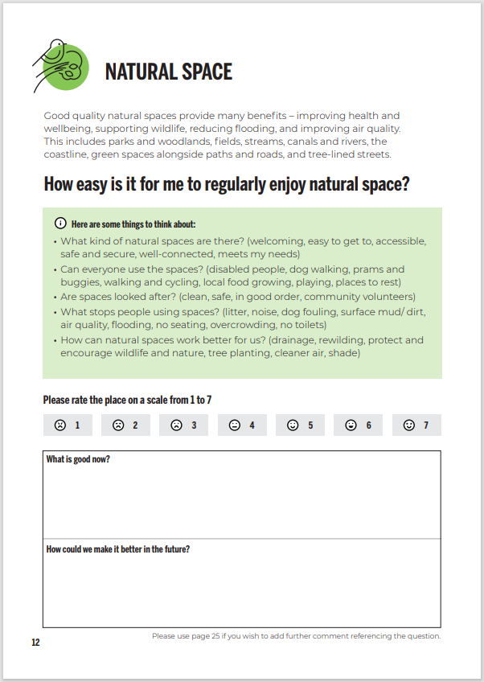
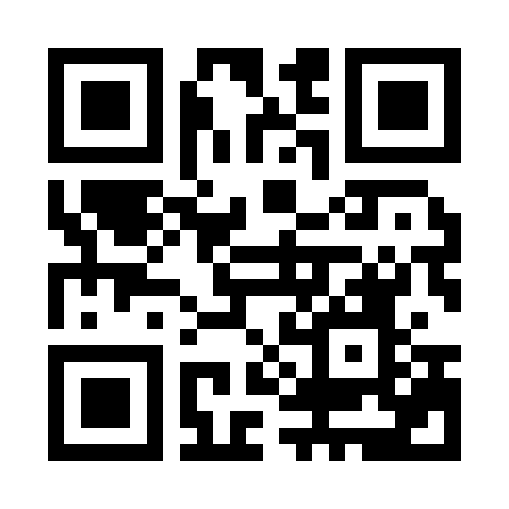
Completing the Survey
Tell us about your place
https://arcg.is/1D8yvS1
Paper copies of the surveys are also available at
16 Church Street, Dumbarton, G82 1QL.

Slide 19
Alternative Versions
Tell Us About Your Place for children (primary school age) https://arcg.is/HiCCu
Tell Us About Your Place for young people (ages 12 to 25) https://arcg.is/CeiP8
The place standard is also available in different languages (including Arabic, Chinese, Polish and Ukranian) here: https://www.ourplace.scot/place-standard-tool-translations

Slide 20
Quick Updates
Local Place Plans
Self-Build List
Communities are invited to prepare local place plans which will inform the local development plan before 30th June 2025.
An Easy Read Guide – Just Published
Community Grant Applications (first round 2nd September)
More information: https://www.west-dunbarton.gov.uk/council/key-council-documents/local-development-planning/local-place-plans/
The self-build list helps us to understand the demand for self-build housing in the area.
More information: https://www.west-dunbarton.gov.uk/planning-building-standards/self-build/
Sign Up: https://arcg.is/1uDqvm0

Slide 21
Next Steps
The surveys are open from 8 July to the 30 September via the QR codes below.
Tell us about your place
Call for Evidence
https://arcg.is/1D8yvS1
https://arcg.is/1bLzan0
Paper copies of the surveys are also available at
16 Church Street, Dumbarton, G82 1QL.

Slide 22
Drop-in Sessions
Virtual Drop-in events
In Person drop-in events, with presentation at 4.30pm
28th August, 10am - 11:30am
3rd September, 6:30pm - 8pm
Concord Centre, 25th July, 3pm – 7pm.
Alexandria Community Centre, 28th August, 3pm – 7pm.
Dalmuir Community Centre, 11th September, 3pm – 7pm

Slide 23
Stay in Touch
Development Plan webpage
https://www.west-dunbarton.gov.uk/council/key-council-documents/local-development-planning/development-plan/
Any questions or comments contact us:
ldp@west-dunbarton.gov.uk
Sign up to the Local Development Planning Mailing List: https://arcg.is/5WeK0

Slide 24
Thank You

